Slide 1
W3C’s Standardization on WoT and Smart Cities
W3C Staff Contact for Web of Things and Media&Entertainment
W3C Project Specialist, Smart Cities Industry Champion
Project Professor, Graduate School of Media and Governance, Keio University
Kazuyuki Ashimura
3 February 2022

Slide 2
ToC
Web technologies for various industries
Web standardization by W3C
WoT (Web of Things)
Smart Cities

Slide 3
Web technologies for various industries

Slide 4
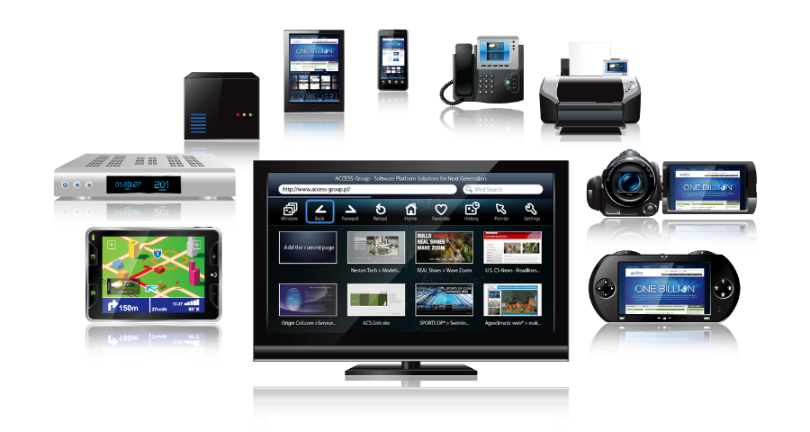

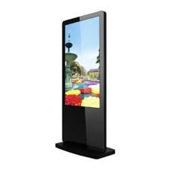
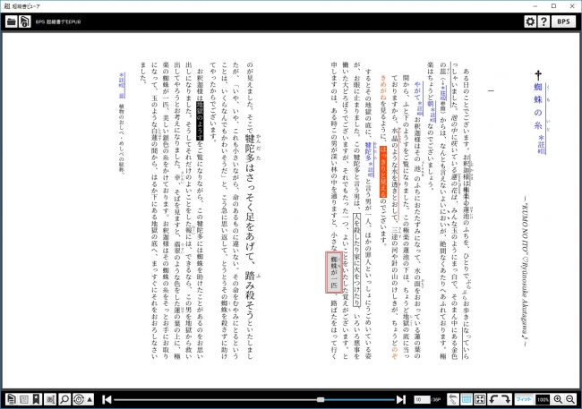
Web technology available everywhere
Smartphones
IP phones
Tablets
STBs
Printer
Video recorders
Videocams
IVI devices
Game devices
TVs
PCs
E-books
Digital signages
デジタルサイネージ
Notes:
This is just a few of the areas where the IoT is being applied

Slide 5
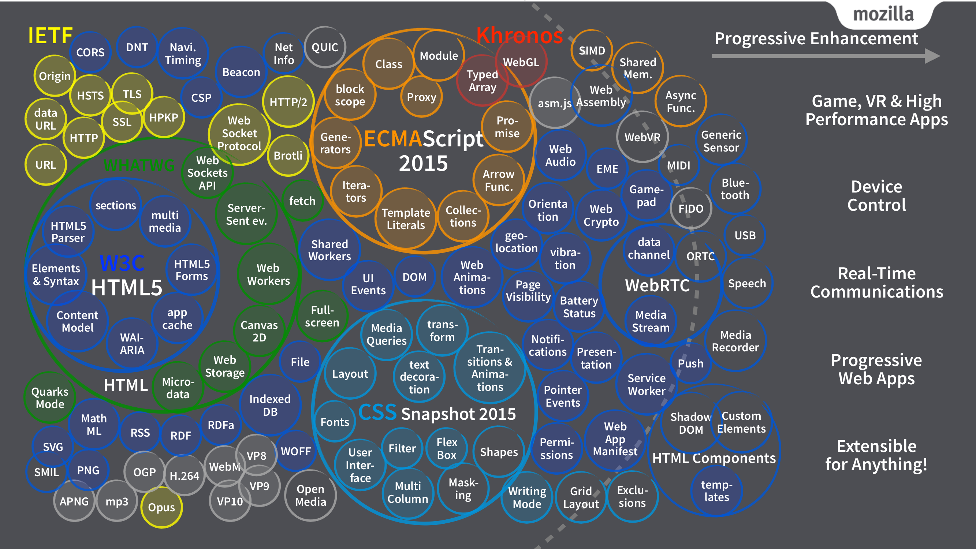
Open Web Platform: HTML5 and related specs
(by Tomoya Asai from WebDINO; former Mozilla Japan (http://webapi.link))
Notes:
This is just a few of the areas where the IoT is being applied

Slide 6
Familiar examples of HTML5 features
Video/Audio capability without plug-ins
Duplex network connection using WebSocket
2D/3D graphics using Canvas
Local data storage
Pulti-processing using Worker
Your friendly WebApps:
Google
Amazon
Facebook
Netflix
Etc.
Notes:
This is just a few of the areas where the IoT is being applied

Slide 7
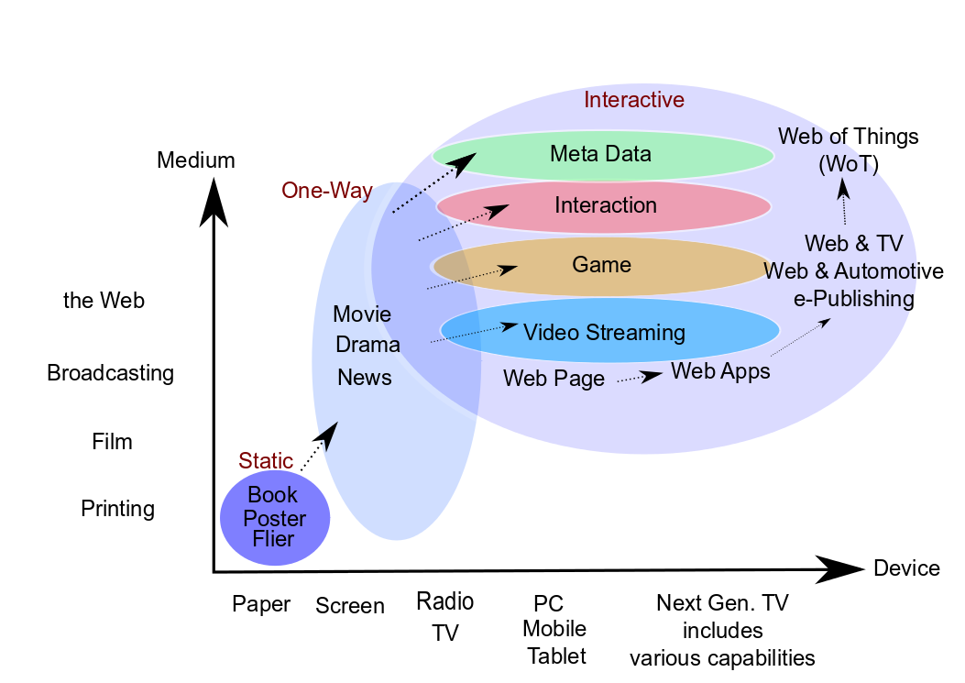
Web as platform for data transfer - Independent from devices or OSs

Slide 8
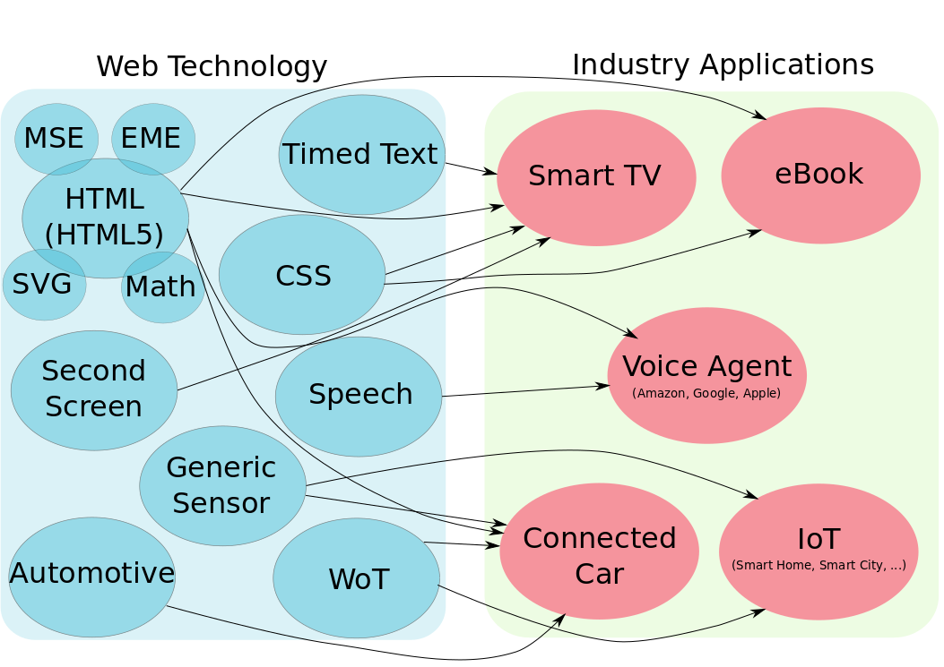
Web standards applied to various industries

Slide 9
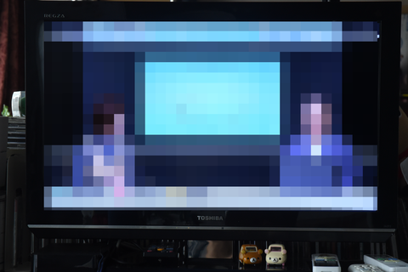
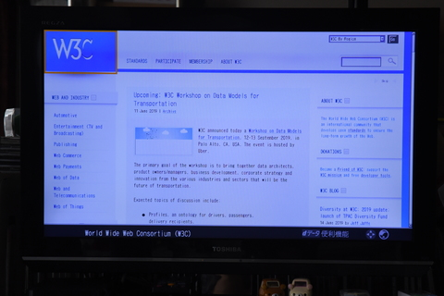
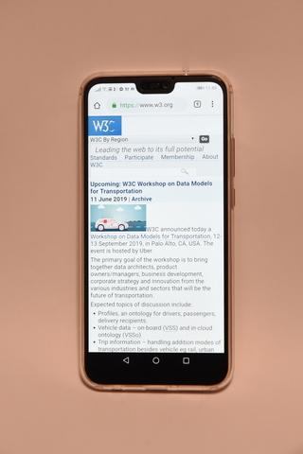
TV ー Broadcasting and communications
Broadcasting content from the tuner
Web content from the browser
Smart collaboration using
another browser on the smartphone

Slide 10
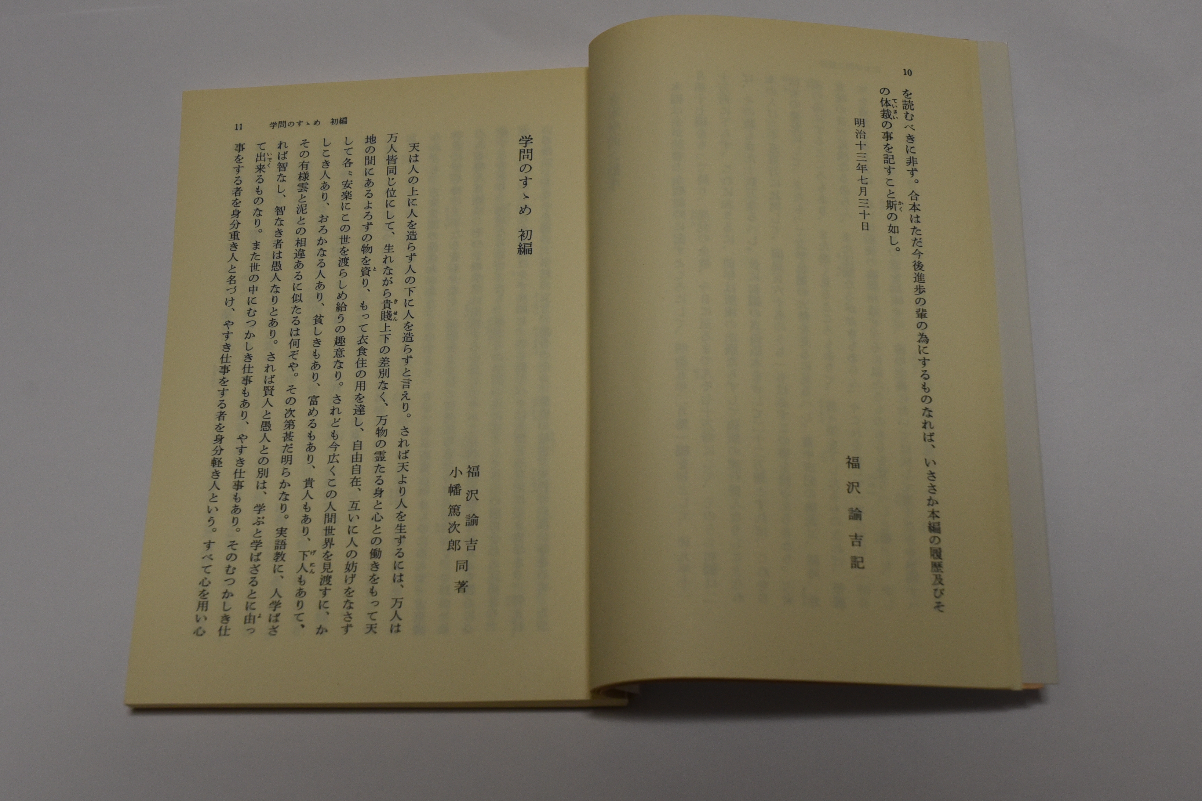
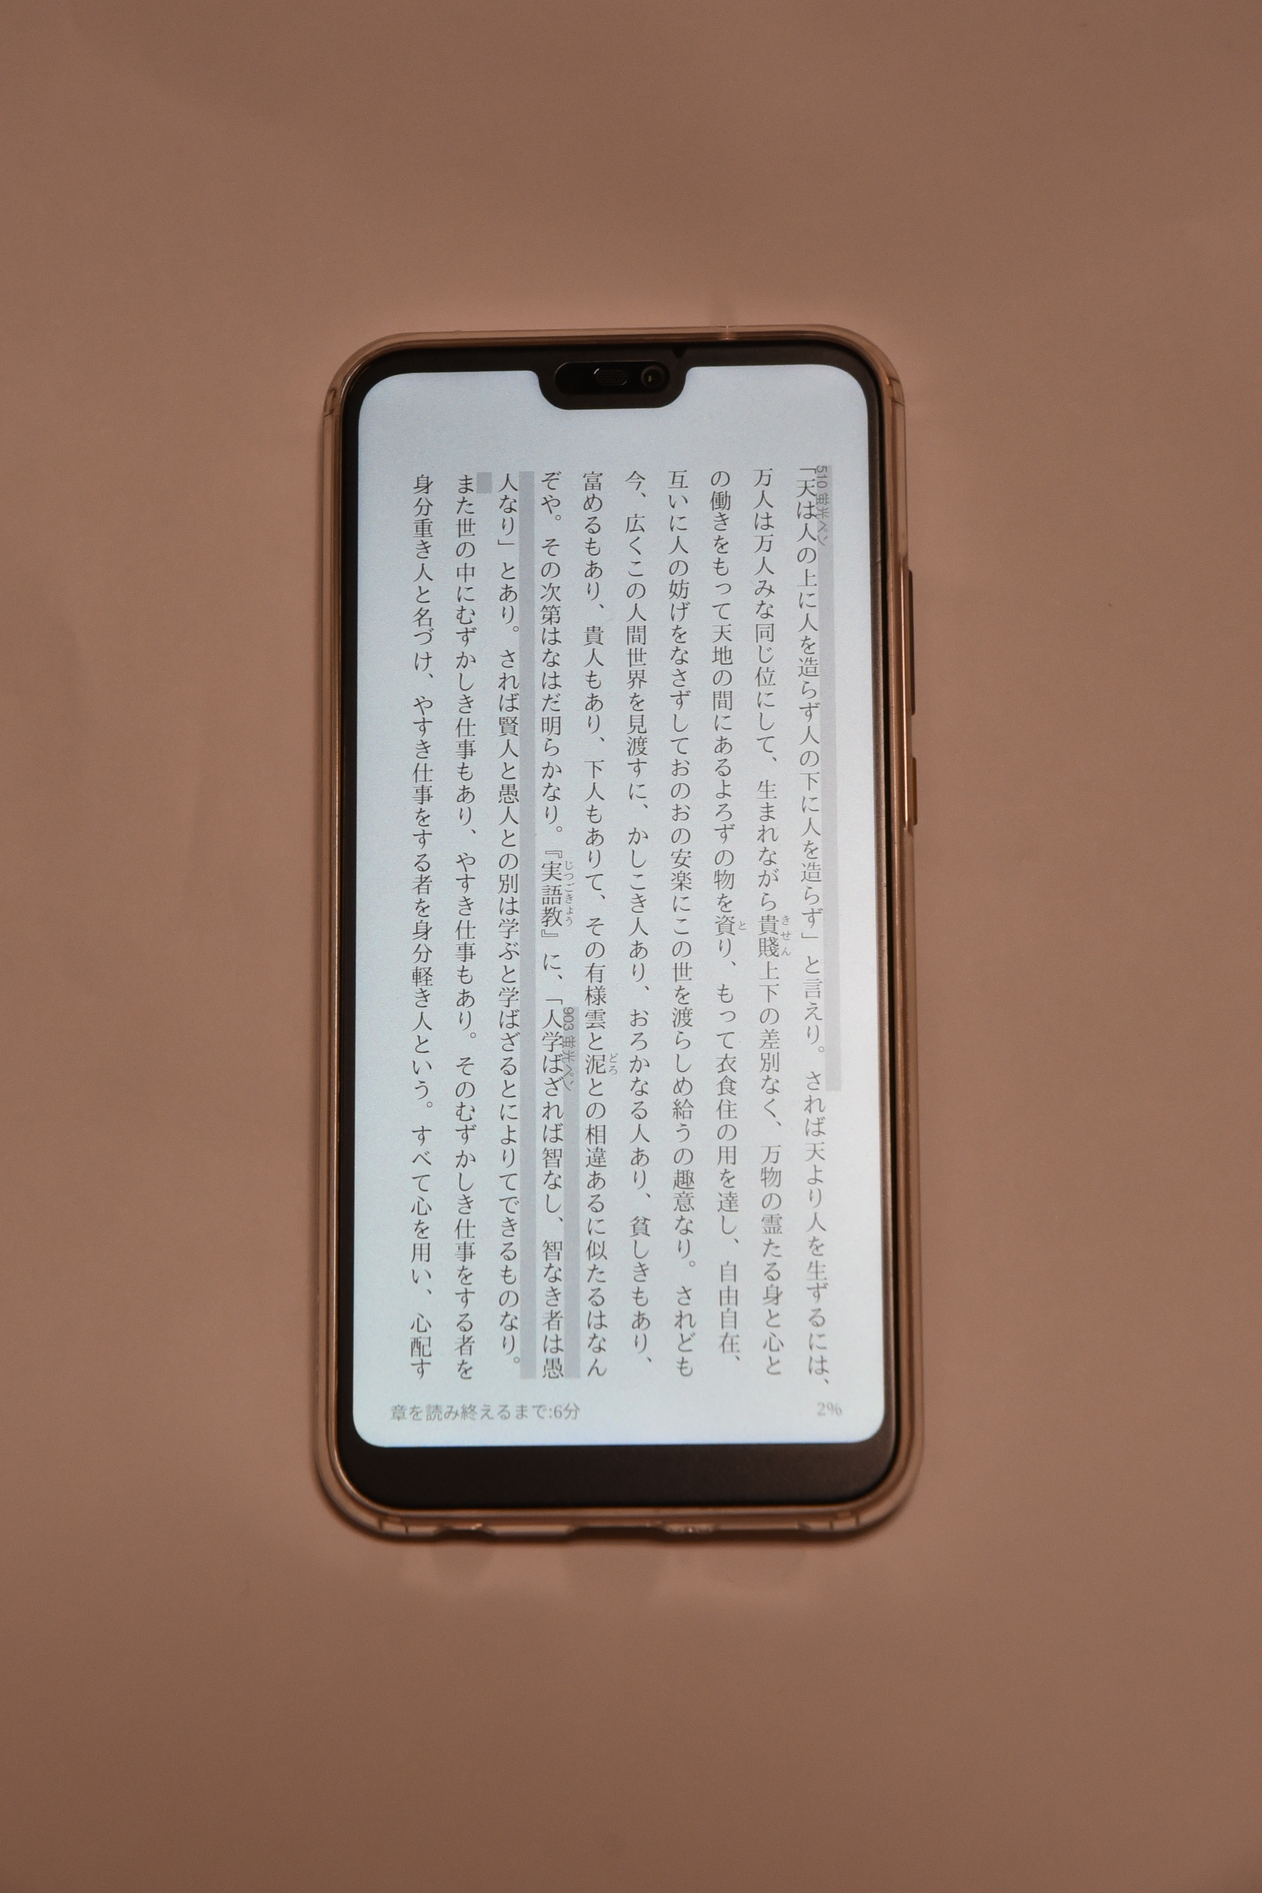
Publishing ― From paper books to E-Books
Paper books
E-Books (Web browser)

Slide 11
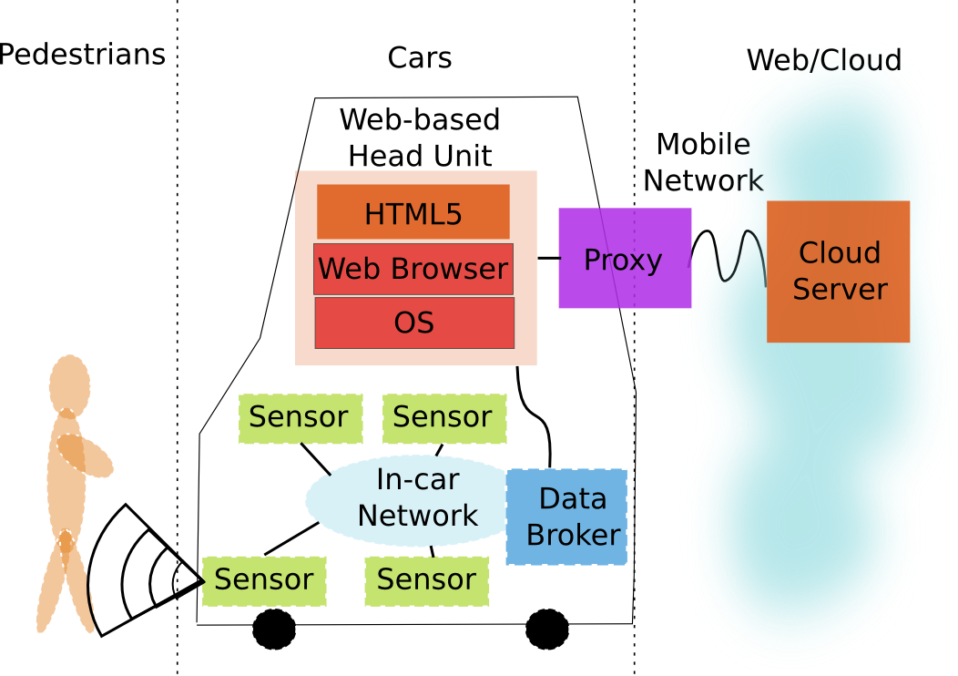
Automotive ―Connected cars using the Web technology

Slide 12
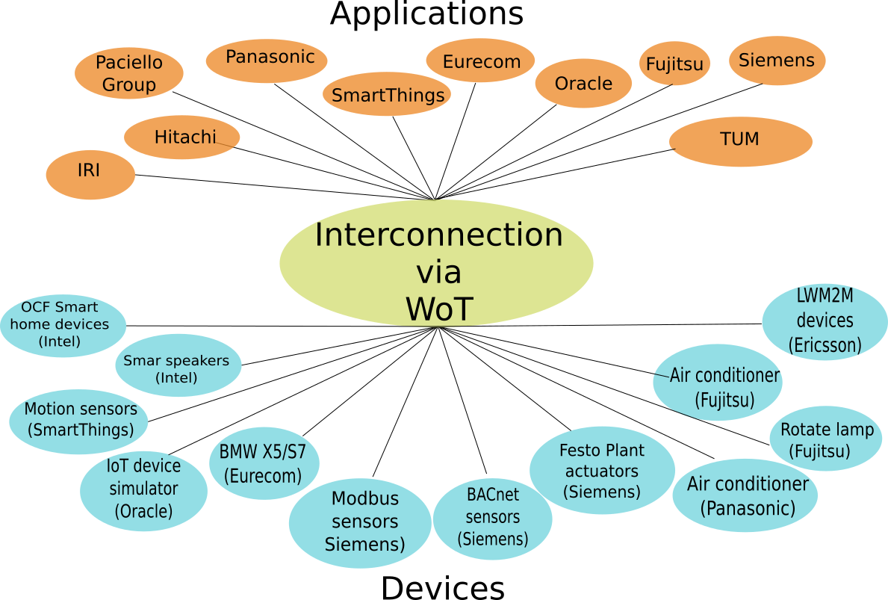
And now for IoT ―WoT: IoT interconnection using the Web technology

Slide 13
Web standardization by W3C

Slide 14
W3C: The World Wide Web Consortium
Lead the Web to its full potential!
Established in 1994 by the W3C Director, Tim Berners-Lee
International consortium for Web’s interoperability
Generating W3C Recommendations, e.g., HTML5
⇒ W3C is the one and only SDO tackling Web standards
established by the Web inventor, Tim Berners-Lee!
Notes:
This is just a few of the areas where the IoT is being applied

Slide 15


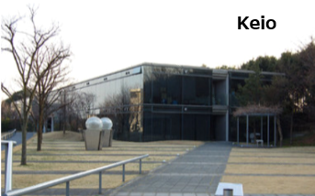

4 hosting organizations
US：MIT
Europe：ERCIM
Japan：Keio university（W3C/Keio Team established in 1996）
China：Beihang university
Notes:
This is just a few of the areas where the IoT is being applied

Slide 16
Web standardization: One Web / Web for All
Standardization is very important for the Web because it interconnects everything!
Interoperability
Multilinguality
Multi-Modality
Accessibility
⇒ available at anytime, anywhere, for anyone
Notes:
This is just a few of the areas where the IoT is being applied

Slide 17
W3C Members
Global participation：
459 organizations/companies (browser, Web service, CE, communications, publishing, etc.)
US/Canada：GAFA, Microsoft, IBM, Adobe, Airbnb, Akamai, Amex, Apache, AT&T, Cisco, Comcast, Federal Reserve Bank of Minneapolis, Intel, Mastercard, Mozilla, Netflix, OASIS, Oracle, Shopify, Thomson Reuters, Verizon, Visa, Walt Disney, Wikimedia, …
Europe：BBC, CERN, Ericsson, Fraunhofer, GS1, JLR, SAP, Siemens, Viacom, Volkswagen, Volvo, …
China：360, Agora.io, Alibaba, Baidu, Beihang Univ., Beijing Haitai Fangyuan Technologies, Beijing Univ. of Posts and Telecom., Bilibili, China Mobile, CAS, Huawei, Tencent, Xiaomi, …
Korea ：ETRI, Gooroome, INCA, Inswave Systms, KETI, LG, Samsung, SCE Kora, SEAK
Japan: ACCESS, Alfasado, BPS, DSA, DDS, Dentsu, Design Inc., DCA, EdMuse, EBPAJ, FLUX, Fujitsu, FTL, Gardenia, Hitachi, Infours, Internet Academy, IRI, JPRS, JCB, Kadokawa, KDDI, Keio Univ., Kodansha, LINE, Media Do, Mitsubishi Electric, Mitsue-Links, NEC, Newphoria, NHK, NTT, Panasonic, Rakuten, Shueisha, SIVIRA, Softbank, Sony, JBA, Toshiba, Voyager Japan, Yahoo Japan
Notes:
This is just a few of the areas where the IoT is being applied

Slide 18
W3C Groups ー Working Groups and Interest Groups
Working Groups (43):
Accessibility Education and Outreach, Accessibility Guidelines, Accessible Platform Architectures, Accessible Rich Internet Applications, Audio, Audiobooks, Automotive, Browser Testing and Tools, Cascading Style Sheet (CSS), Dataset Exchange, Decentralized Identifier, Devices and Sensors, Distributed Tracing, EPUB 3, GPU for the Web, HTML, Immersive Web, Internationalization, JSON-LD, Math, Media, MiniApps, Pointer Events, Portable Network Graphic (PNG), Second Screen, Service Workers, Spatial Data on the Web, SVG, Timed Text, Verifiable Credentials, Web Application Security, Web Applications, Web Authentication, Web Editing, Web Fonts, Web Machine Learning, Web of Things, Web Payments, Web Performance, Web Platform, Web Real-Time Communications, WebAssembly, WebTransport
Interest Groups (9):
Chinese Web, Internationalization, Media and Entertainment, Patents and Standards, Privacy, WAI, Web & Networks, Web of Things, Web Payment Security
Notes:
This is just a few of the areas where the IoT is being applied

Slide 19
W3C groups ― Business Groups and Community Groups
Business Groups (3):
Automotive and Transportation, Improving Web Advertising, Publishing
Community Groups (366):
AI KR, Algorithmic Modelling, Automotive Ontology, Big Data, Blockchain, Bullet Chatting, Cloud Computing, Color on the Web, Credentials, EPUB 3, HTTPS in Local Network, Machine Learning for the Web, MiniApps Ecosystem, Revising W3C Process, Schema.org, Speech API, Web Platform Incubator (WICG), …
Notes:
This is just a few of the areas where the IoT is being applied

Slide 20
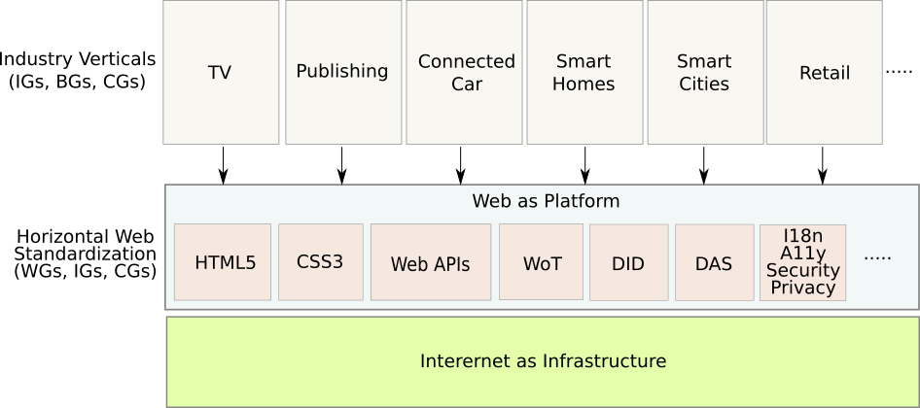
Layers of the W3C standardization groups

Slide 21
WoT (Web of Things)

Slide 22
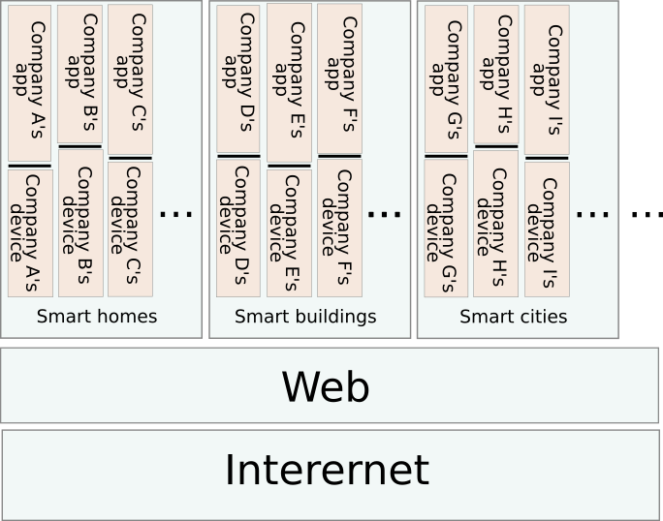
Problems of IoT silos

Slide 23
PlugFest: Proof-of-Concept for interconnectivity

Slide 24
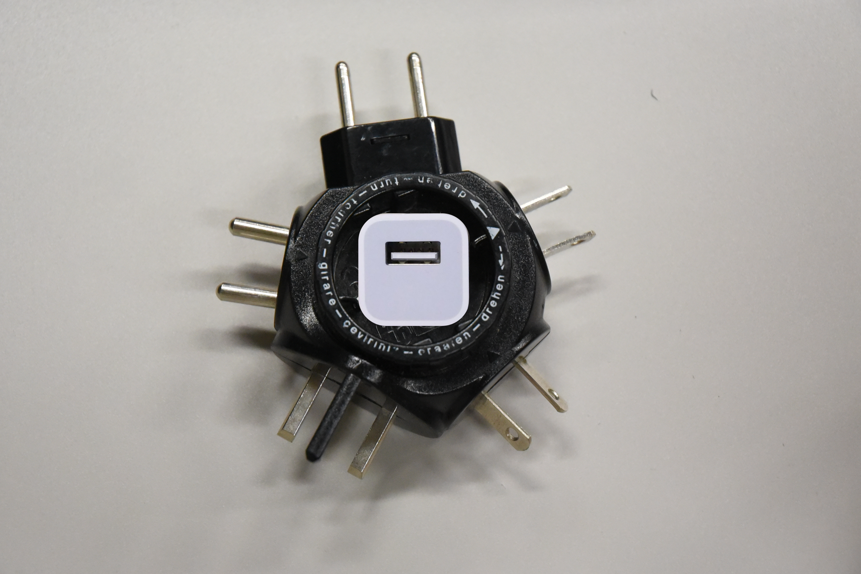
Like this ☺
Integrating various IoT standards using the Web

Slide 25
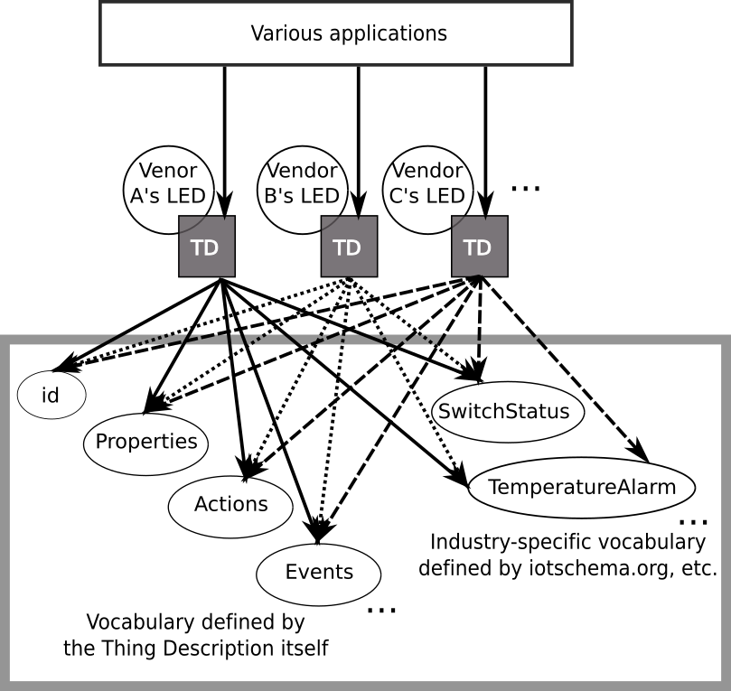
Unified vocabulary references by Thing Description

Slide 26
Expected use cases for the future apps

Slide 27
WoT 1.1 Use Cases ― Multi-vendor integration
So far…
Just part of the discussion for the WoT specifications by the WoT WG
However, since this year…
Getting inputs/ideas from the WoT IG participants as well as the WoT WG participants
and even from the outside of the W3C ☺
Working area:
https://github.com/w3c/wot-architecture/tree/master/USE-CASES
Consolidated document on Use cases and Requirements:
https://w3c.github.io/wot-usecases/

Slide 28
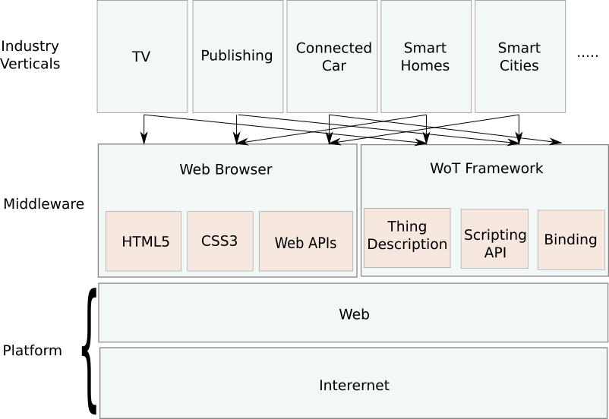
WoT Positioning ― Middleware for IoT purpses based on the Web platform!

Slide 29
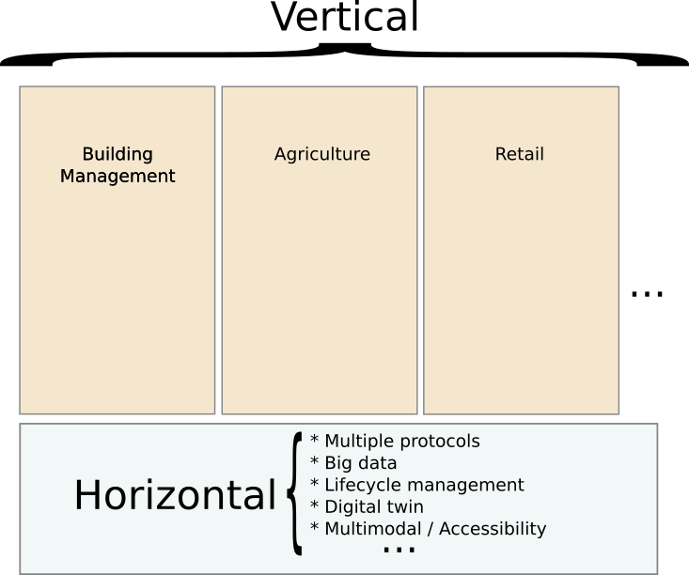
Categorization of the use cases - collaborative work with related WGs and SDOs
Vertical (Industry-dependent)
Devices and Sensors
Automotive
Media and Entertainment
Other SDOs
Horizontal (Industry-independent)
Accessibility
Privacy
Security
Internationalization

Slide 30
Use cases – Vertical ones
TV industry
Media distribution
Multi-program collaboration
AR/VR
Smart agriculture
Plastic greenhouse
Openfield management
Smart water management
Smart building
Sensors
Maintenance
Smart city
IoT mashup
Geolocation
Healthcare
Others
Retail
Traffic
Smartgrid
Education
Medical care

Slide 31
Use cases – Horizontal ones
Digital twins
Multi-protocol integration
Big data
Lifecycle management
Multimodal interfaces (improved UX)
AI & Machine learning
Edge computing
IoT orchestration

Slide 32
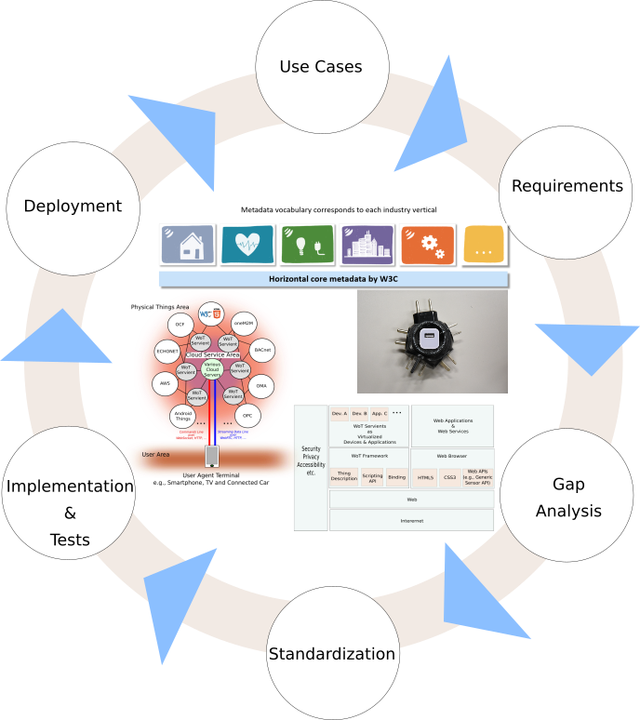
Extracting requirements from all the use cases ― collaboration with industries and SDOs

Slide 33
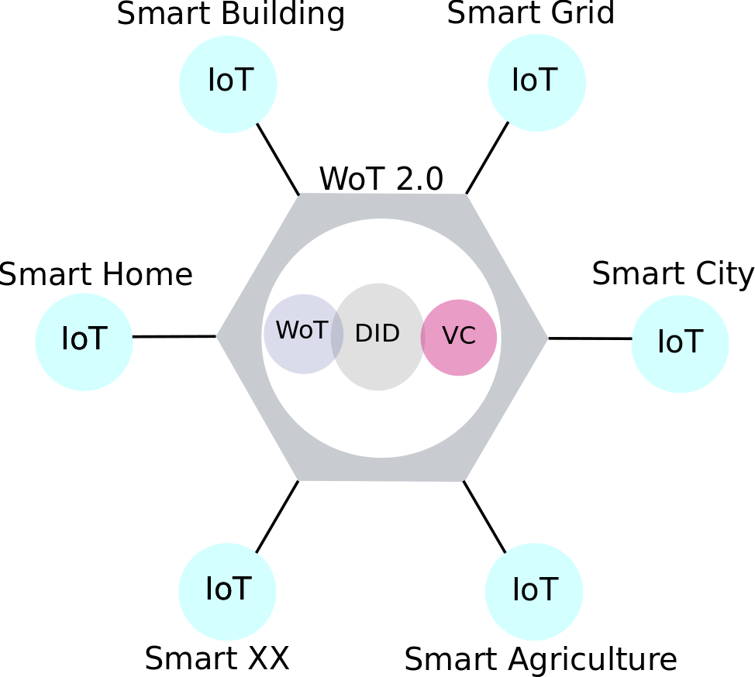
Then towards WoT 2.0: WoT + DID + VC
Managing devices and users using the DIDs:
DID: Decentralized Identifiers
IDs for identify devices and users
Encrypted and distributed
Blockchain is a possible system platform
WoT: Web of Things
Standard description for devices’ capability and behavior
VC: Verifiable Credentials
Standard description for users’ credentials
Encrypted and self-sovereign

Slide 34
Smart Cities

Slide 35
Pros and Cons of Smart Cities…
“Smart City” by Wikipedia: https://en.wikipedia.org/wiki/Smart_city
An urban area that uses different types of electronic methods and sensors to collect data.
Insights gained from that data are used to manage assets, resources and services efficiently; in return, that data is used to improve the operations across the city.
The smart city concept integrates information and communication technology (ICT), and various physical devices connected to the IoT (Internet of things) network to optimize the efficiency of city operations and services and connect to citizens.
Smart city technology allows city officials to interact directly with both community and city infrastructure and to monitor what is happening in the city and how the city is evolving.
Notes:
This is just a few of the areas where the IoT is being applied

Slide 36
Various Adoptions All Over the World
Amsterdam
Barcelona
Columbus, Ohio
Copenhagen
Dubai
Dublin
Gdynia
Isfahan
Kyiv
London
Madrid
Malta
Manchester
Milan
Milton Keynes
Moscow
New Songdo City
New York
San Leandro
Santa Cruz
Santander
Shanghai
Singapore
Stockholm
Taipei
Tokyo
…
Notes:
This is just a few of the areas where the IoT is being applied

Slide 37
Need for a Standardization
"Smart Cities" consists of (too) many stakeholders (vendors, users, governments, …) and technologies (Web, IoT, Software, Hardware, …).
So strong need:
To identify and document use cases and requirements that W3C specifications need to meet to support Smart City services and users,
To obtain feedback from all stakeholders on the usage of Web technologies for Smart Cities,
To gather expert input on important features for Smart Cities based on Web technology, and
To provide a forum for technical and business discussions related to Smart Cities.
Notes:
This is just a few of the areas where the IoT is being applied

Slide 38
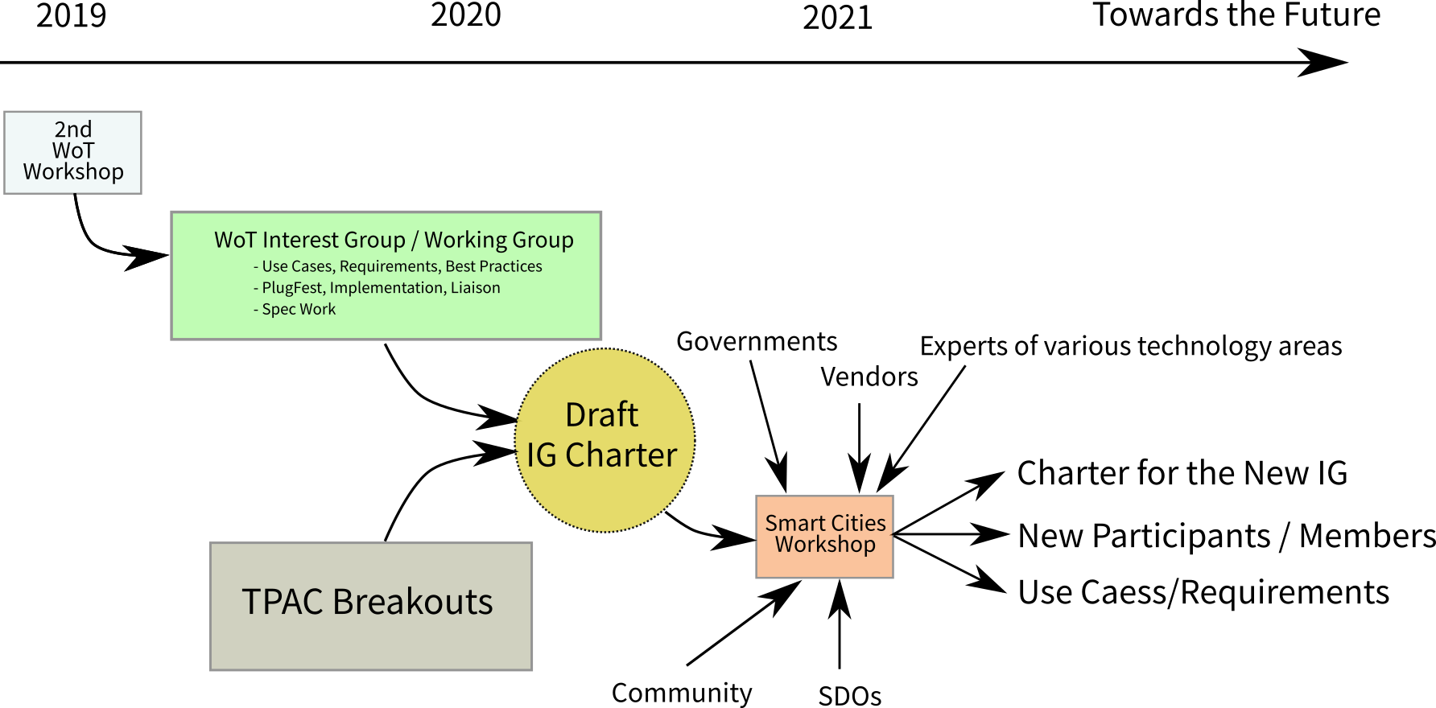
Smart Cities Discussion at W3C
Notes:
This is just a few of the areas where the IoT is being applied

Slide 39
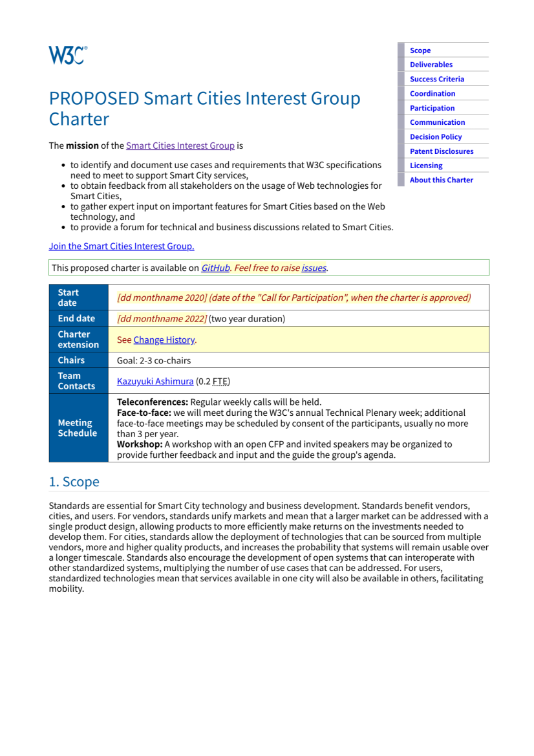
Goals and Deliverables of The Workshop
Identify stakeholders of Smart Cities standardization to drive the development of Web standards aligned with the real needs of Smart Cities
Clarify reasonable applications for Smart Cities technologies we agree to build
See how to improve the draft Charter for the potential Smart Cities Interest Group for further discussions
⇒ Workshop report:
https://www.w3.org/2021/06/smartcities-workshop/report.html
⇒ Draft Charter for a W3C Interest Group:
https://w3c.github.io/wot/charters/smart-cities/smart-cities-ig-charter.html
Notes:
This is just a few of the areas where the IoT is being applied

Slide 40
Workshop Discussions – Use Cases
Heng QIAN: The Uniqueness of Smart City ICT
Peter Lee: Smarter Suffolk (UK) case study
Josh Lieberman: Socializing Urban Digital Twins
Daihei Shiohama: Publishing WoT use case for Japan Smart Cities
Notes:
This is just a few of the areas where the IoT is being applied

Slide 41
Workshop Discussions – Existing Standards
Jerome Blum: ECLASS as a standardized Taxonomy, Terminology and Semantic for Smart Cities
Clarissa Loureiro: Smart City Maturity Model for Developing Countries Scenarios
Notes:
This is just a few of the areas where the IoT is being applied

Slide 42
Workshop Discussions – Web-based Approach
Sebastian Kaebisch: Standardized Service Orchestration in Smart City
Michael McCool: The Web of Things in the Smart City
Andrea Cimmino: Shifting from smart cities to smart communities using Web technologies
Jacqueline Lu: Transparency Interfaces for Everyday Places
Dave McComb: Lessons Learned from Enterprise Ontologies to Smart Cities
Notes:
This is just a few of the areas where the IoT is being applied

Slide 43
Workshop Discussions – Cross-cutting Issues
Sisay Chala, Otilia Werner-Kytölä: Privacy-Aware Information Base in the Context of Smart Cities
Deborah Dahl: Intelligent User Interfaces to Smart Cities
Baoping CHENG: Multimedia communication technology reshapes smart home life
Kaz Ashimura: Data Governance for Smart Cities
Notes:
This is just a few of the areas where the IoT is being applied

Slide 44
W3C Standardization Cycle ― based on industry use cases and implementations

Slide 45
Criticism
As a globalized business model is based on capital mobility, following a business-oriented model may result in a losing long-term strategy: "The 'spatial fix' inevitably means that mobile capital can often 'write its own deals' to come to town, only to move on when it receives a better deal elsewhere. This is no less true for the smart city than it was for the industrial, [or] manufacturing city."
The high level of big data collection and analytics has raised questions regarding surveillance in smart cities, particularly as it relates to predictive policing.
As of August 2018, the discussion on smart cities centres around the usage and implementation of technology rather than on the inhabitants of the cities and how they can be involved in the process.
Notes:
This is just a few of the areas where the IoT is being applied

Slide 46
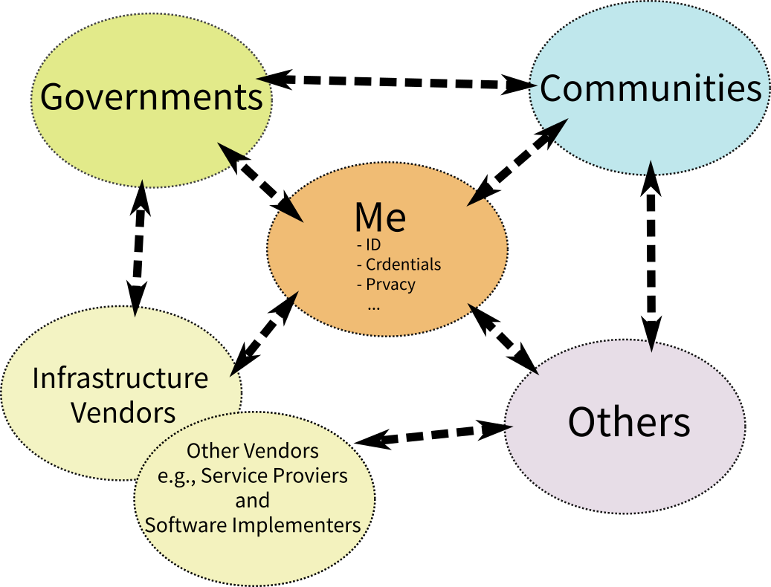
Data Governance for Smart Cities
Data Transfer among various stakeholders
Who
What
When
How
Need clarification based on concrete Use Cases by a dedicated IG ☺
Notes:
This is just a few of the areas where the IoT is being applied

Slide 47
Please remember Web technology for whom? - When / Where / For whom / How it works
Various possible stakeholders and roles
Governments?
Content producers?
Network providers?
System developers?
Hardware vendors?
Infrastructure providers?
Service providers?
Users (=Everybody) ⇐ Most important stakeholders！

Slide 48
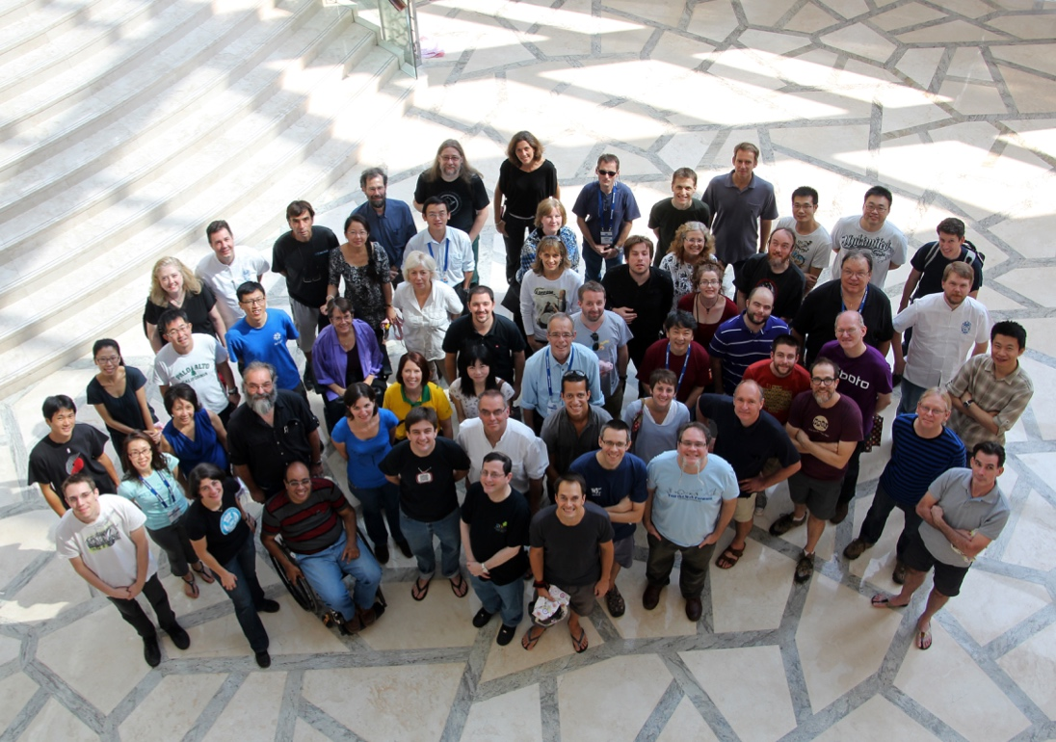
Thank you!
May the Web standards be your companion helping you improve the world!
Notes:
Image: show human to human

Slide 49
Details of WoT
To be described by
Michael McCool and Sebastian Kaebisch ☺

Slide 50
Appendix

Slide 51

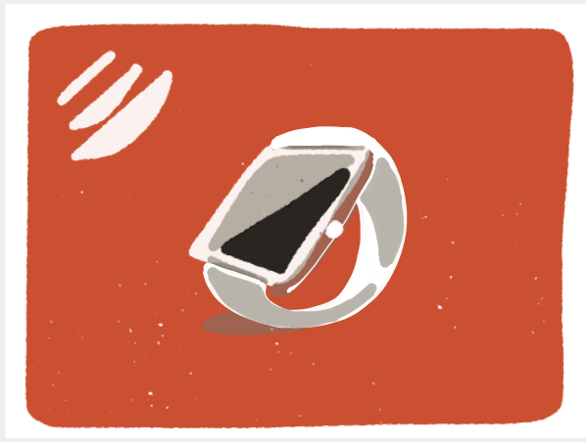




Various IoT platforms
Smart Homes
Wearables
Healthcare
Power & Environment
Smart Cities
Manufacturing
Notes:
This is just a few of the areas where the IoT is being applied

Slide 52
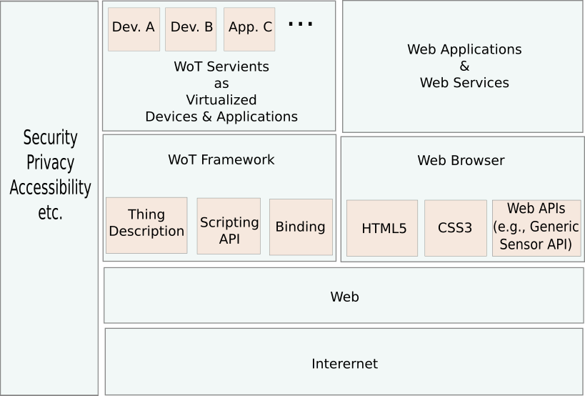
WoT: IoT interconnection using the Web - Web as the platform for data transfer

Slide 53
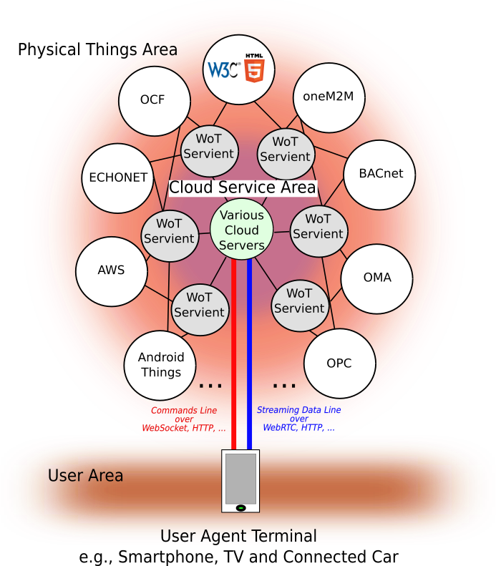
WoT connects various IoT platforms with the Web

Slide 54

























WoT participants within W3C

Slide 55









Liaison with related SDOs
INDUTRIE 4.0
Industrial Internet Consortium
Open Connectivity Foundation
OPC Foundation
IETF/IRTF
oneM2M
AIOTI
Etc.
AIOTI
Notes:
We’ve set up a collaboration agreement with the IIC which is not an standards organisation itself. The Open Connectivity Foundation is a recently announced rebranding on the Open Interconnect Consortium (OIC). We’ve had presentations from OIC and likewise given presentations to the OIC. OIC started with Intel, Samsung, Cisco and others, then brought in Microsoft for their work on UPnP, and with the rebranding as OCF, have now brought in Qualcomm. We’ve had quite a few meetings with Industrie 4.0 and they generally agree with our approach. We’re having discussions with the OPC Foundation, e.g. in respect to semantic interoperability and security frameworks. W3C has good links with the IETF and its sibling the IRTF (Internet Research Task Force), particulary the IRTF’s Thing to Thing Research Group. We have good connections to OneM2M especially in regards to semantic interoperability. AIOTI was set up as a public-private partnership between the European Commission and Industry in respect to European funding for IoT. We’re working with AIOTI on semantic interoperability.

Slide 56
Standardization status - REC Track documents (=W3C Specs)
WoT Architecture:
Ver 1.0: https://www.w3.org/TR/2020/REC-wot-architecture-20200409/ (REC)
Ver 1.1: https://www.w3.org/TR/2020/WD-wot-architecture11-20201124/ (FPWD)
WoT Thing Description (TD):
Ver 1.0: https://www.w3.org/TR/2020/REC-wot-thing-description-20200409/ (REC)
Ver 1.1: https://www.w3.org/TR/2020/WD-wot-thing-description11-20210607/ (WD)
WoT Discovery: https://www.w3.org/TR/2020/WD-wot-discovery-20210602/ (WD)
WoT Profile: https://www.w3.org/TR/2020/WD-wot-profile-20201124/ (FPWD)

Slide 57
Standardization status - REC Track documents (=W3C Specs)
WoT Architecture:
Ver 1.0: https://www.w3.org/TR/2020/REC-wot-architecture-20200409/ (REC)
Ver 1.1: https://www.w3.org/TR/2020/WD-wot-architecture11-20201124/ (FPWD)
WoT Thing Description (TD):
Ver 1.0: https://www.w3.org/TR/2020/REC-wot-thing-description-20200409/ (REC)
Ver 1.1: https://www.w3.org/TR/2020/WD-wot-thing-description11-20210607/ (WD)
WoT Discovery: https://www.w3.org/TR/2020/WD-wot-discovery-20210602/ (WD)
WoT Profile: https://www.w3.org/TR/2020/WD-wot-profile-20201124/ (FPWD)

Slide 58
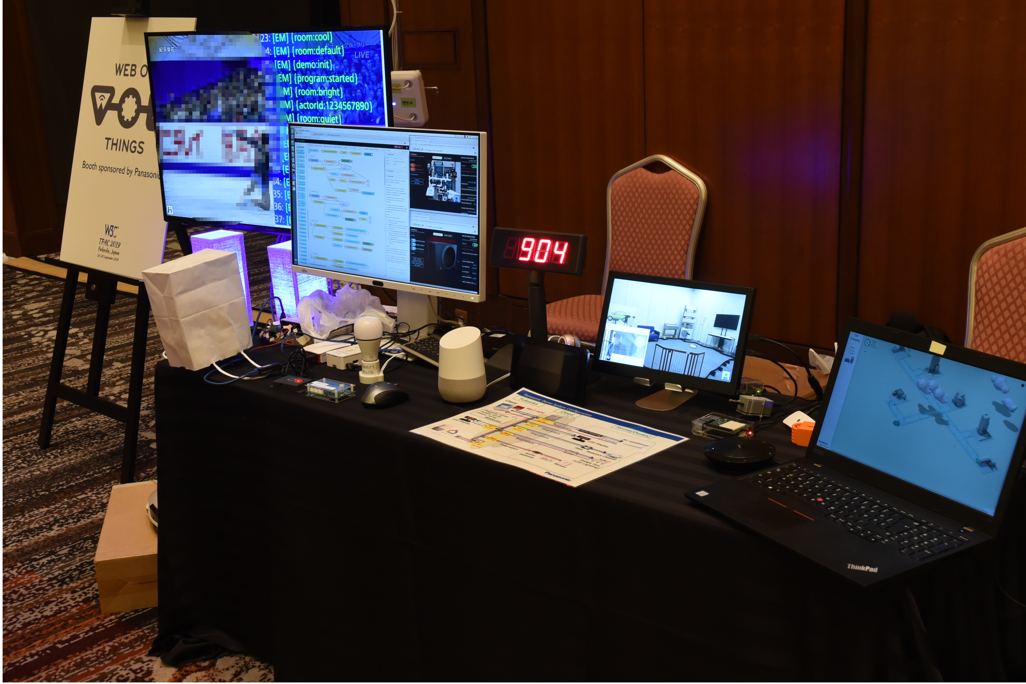
Demo at TPAC2019 in Fukuoka - TPAC (Technical Prenary & Advisory Committee Meetings)
Oracle: Cloud services, Digital twin simulator
Siemens: Electric car charger
Panasonic: Air conditioner, Robot cleaner, Bulletin board, LED lamps
NHK: HybridCast app on TV
Fujitsu: Proxy server, Smart meter, LED lamp, Air conditioner, Battery, Window blinds
Mozilla: WebThing lamp
Hitachi: NodeRED app
Intel: Webcam, Amazon Echo

Slide 59
Demo at virtual TPAC2020
TPAC held as a virtual remote event using Zoom and WebEx
PlugFest demo also held as a virtual event
VPN service using SoftEther to emulate the local network for all the participants
mDNS-based device discovery service using LinkSmart
Participants
Virtual local net using SoftEther VPN
Fujitsu: Proxy service, Various sensors (acceleration, brightness, proximity, PIR, temperature, humidity, air pressure)
Hitachi: LED connected to Raspbery Pi, NodeRED app
NHK: Hybridcast emulator, Hybridcast Connect app, smartphone, haptic device
RIOT OS: BLE prototype
Outside the virtual net (connected via proxies)
TUM: Remote Lab (belt conveyer, HUE LED, IR sensor, Robot arms, Coffee machines)
Siemens: Multi-language counter, Coffee machines, TestThing (including geolocation information), browser UI
Intel: Proxy server, Webcam, Speech synthesis (Amazon Echo)
UNIBO: WoT Farm emulator (virtual sensors and sprinklers)
TPAC Breakout demo
Slides: https://www.w3.org/2020/10/27-wot-breakout/2020-10-WoT-Breakout.pptx
Minutes: https://www.w3.org/2020/10/27-wot-breakout-minutes.html

Slide 60
Demo at Virtual TPAC2021
Similar setting as TPAC2020
Remote PlugFest:
SoftEther VPN
LinkSmart
Participants
Virtual local network (VPN)
ECHONET: LED, Air conditioner, Temp. sensor, Illuminance sensor
Fujitsu: Proxy service, Sensors (acceleration, illuminance, proximity, motion, temp., humidity, pressure)
Hitachi: Raspbery Pi + LEDs, NodeRED
NHK: Hybridcast emulator, Virtual devices (Smart speaker, Smart display, Smart cuttingboard)
RIOT OS: BLE prototype
Internet (via proxy)
TUM: Remote Lab (Belt conveyer, HUE LED, IR sensor, Robot arm, Coffee machine)
Siemens: Directory service, Multi-language counter, Coffee machine, TestThing, Soler panel, Brower UI
Intel: Proxy server, Webcam, Speech synth. (Amazon Echo)
UNIBO: WoT Farm emulator (Sensor and Sprinkler)

